Slide 1



Road accident Dashboard
View in Power BI
Last data refresh:
8/12/2023 3:55:56 AM UTC
Downloaded at:
8/12/2023 4:01:06 AM UTC

Slide 2
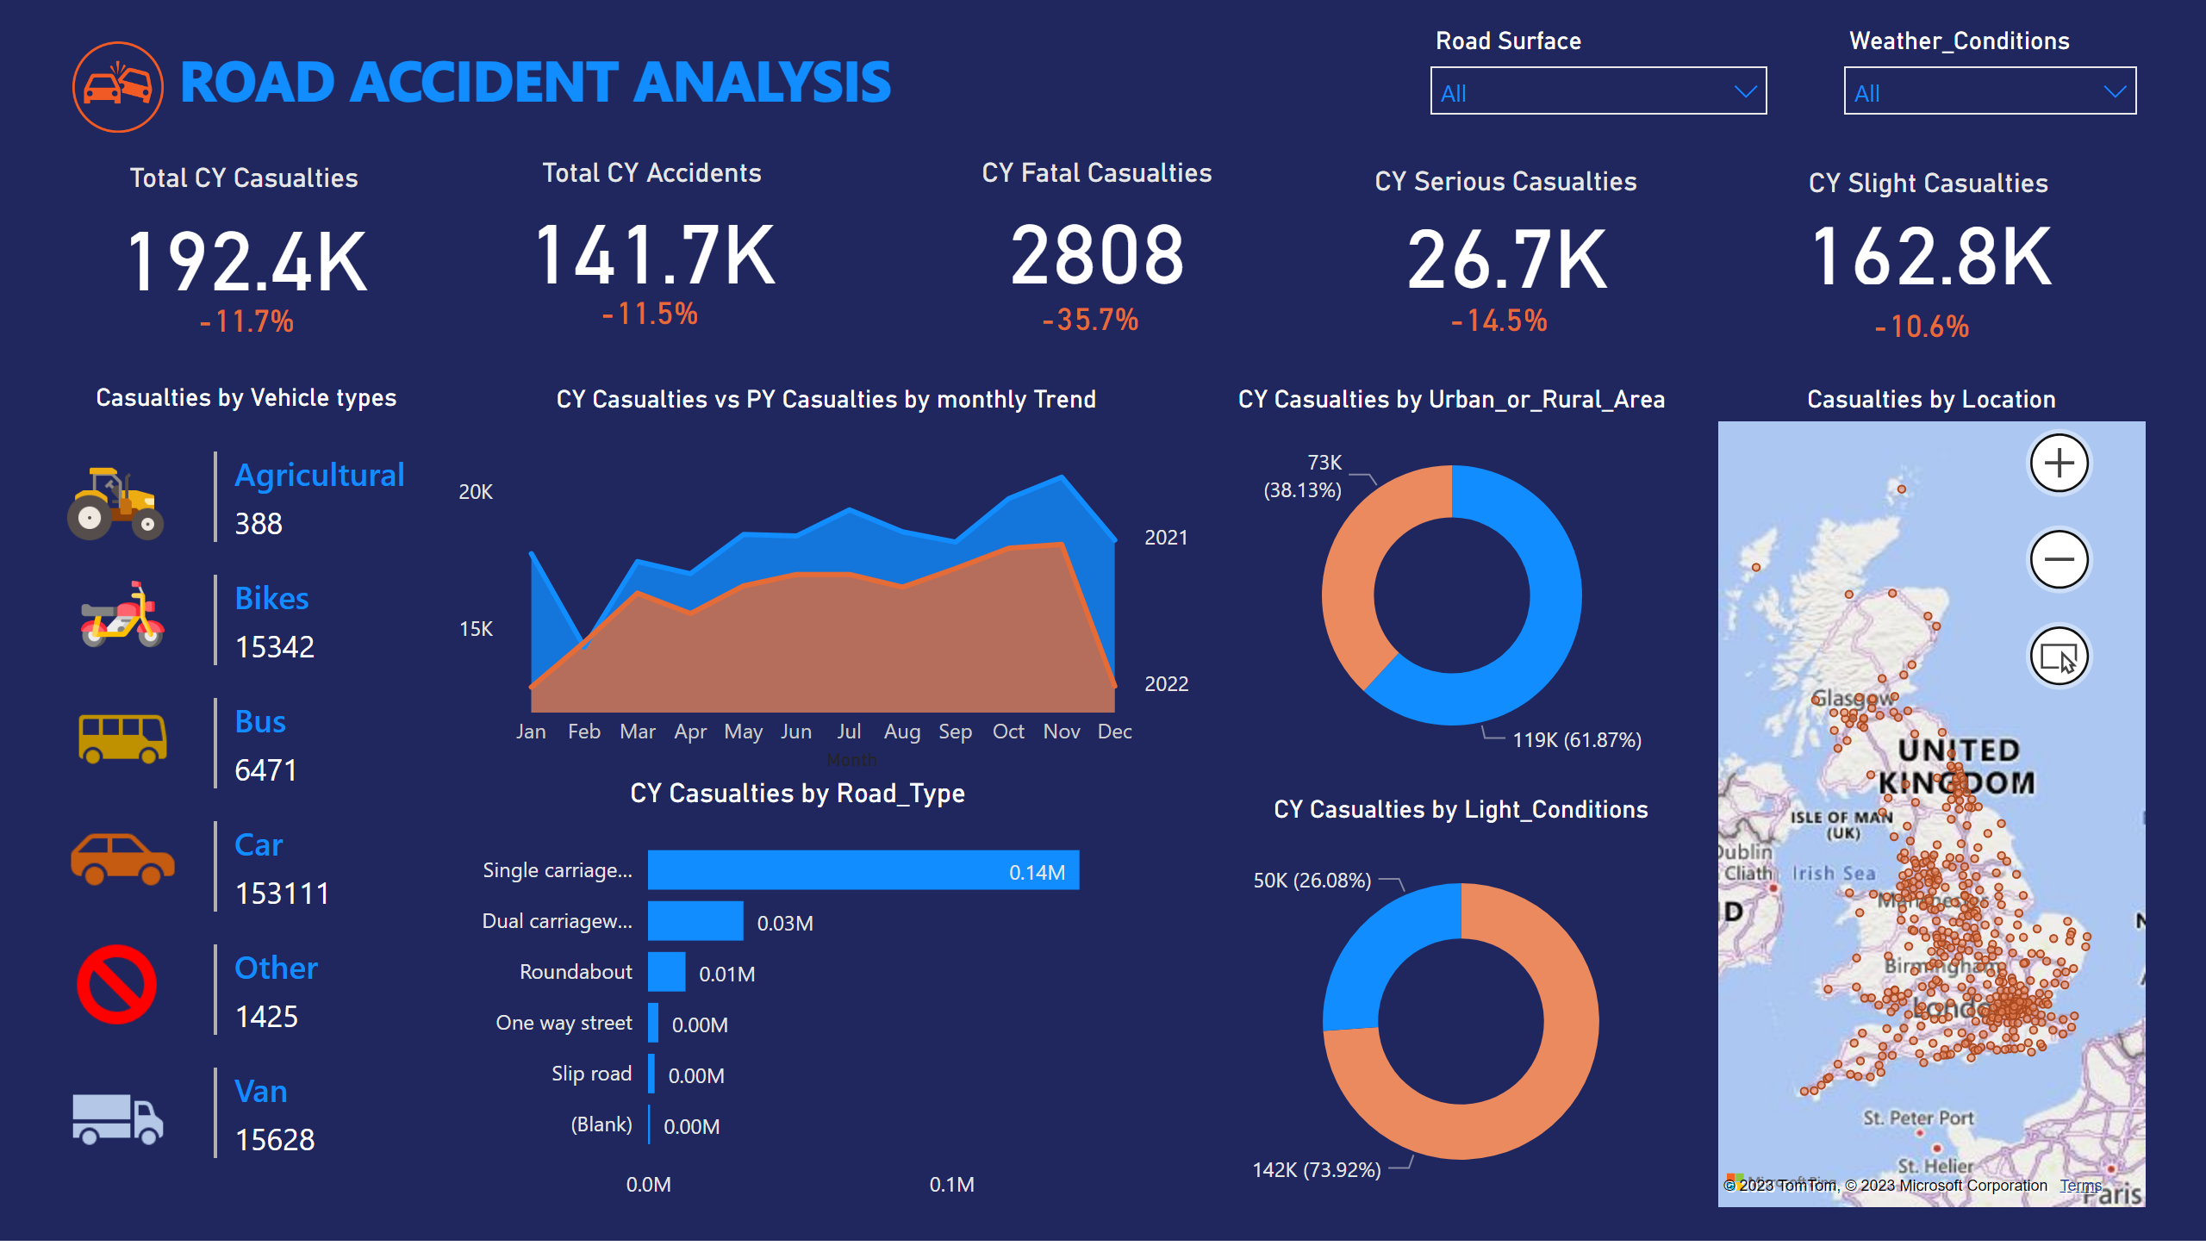
Page 1
Notes:
Total CY Casualties
No alt text provided
card
No alt text provided
Total CY Accidents
No alt text provided
card
No alt text provided
CY Fatal Casualties
No alt text provided
card
No alt text provided
CY Serious Casualties
No alt text provided
card
No alt text provided
CY Slight Casualties
No alt text provided
card
No alt text provided
textbox
No alt text provided
multiRowCard
No alt text provided
CY Casualties vs PY Casualties by monthly Trend
No alt text provided
donutChart
No alt text provided
CY Casualties by Light_Conditions
No alt text provided
barChart
No alt text provided
textbox
No alt text provided
slicer
No alt text provided
slicer
No alt text provided
image
No alt text provided
image
No alt text provided
image
No alt text provided
image
No alt text provided
image
No alt text provided
image
No alt text provided
image
No alt text provided
Casualties by Location
No alt text provided

